Slide 1


How does ChatGPT work?

Slide 2
Part 2
Learning objectives
Concepts
Understand the temporal dimension of language
Understand some basic concepts in attention
query, key, value, self-attention
Understand a head as a representation of a certain relationship between words
Computation
Understand the power of matrix multiplication for parallel computation

Slide 3
Last session
A single self-attention head

Slide 4
A visual of what we have learned so far
HEAD
q
…
x
k
…
v
…

Slide 5
A visual of what we have learned so far
HEAD
q
…
x
k^{T}
…
v
…

Slide 6
A visual of what we have learned so far
HEAD
q
…
·
Attention scores
x
k^{T}
…
v
…

Slide 7
A visual of what we have learned so far
HEAD
-inf mask
q
…
·
x
k^{T}
…
v
…

Slide 8
A visual of what we have learned so far
HEAD
-inf mask
q
…
·
Softmax
to each row
Attention weights
x
k^{T}
…
v
…

Slide 9
A visual of what we have learned so far
HEAD
-inf mask
q
…
·
Softmax
to each row
w
x
k^{T}
…
v
…

Slide 10
A visual of what we have learned so far
HEAD
-inf mask
q
…
·
Softmax
to each row
w
·
v
x
k^{T}
…
…

Slide 11
Any questions?

Slide 12
Multi-head attention mechanism

Slide 13
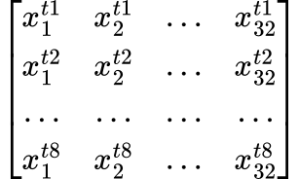
A visual of what we have learned so far
HEAD
-inf mask
Head size= 8
q
…
·
Softmax
to each row
w
·
v
k^{T}
…
32 features
…

Slide 14
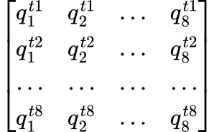
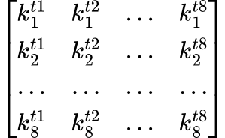
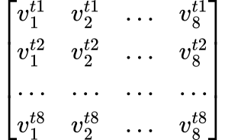
A single head
q
8X8
x
k^{T}
8X8
8X32
v
8X8

Slide 15
A single head
q
8X8
·
w
x
k^{T}
8X8
8X32
v
8X8

Slide 16
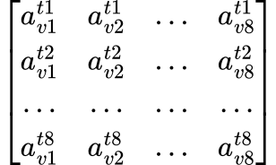
A single head
q
8X8
·
w
8X8
k^{T}
8X8
·
8X32
x
v
8X8
8X8

Slide 17
A single head
q
8X8
·
w
8X8
x
k^{T}
8X8
·
a^{h1}
8X32
8X8
v
8X8

Slide 18
A single head
q
8X8
·
w
8X8
x
k^{T}
8X8
·
a^{h1}
8X32
8X8
v
8X8

Slide 19
A single head
x
HEAD 1
a^{h1}
8X32
8X8

Slide 20
Multi-head

Slide 21
Multi-head
HEAD 1
a^{h1}
8X8
a^{h2}
HEAD 2
8X8
x
8X32
a^{h3}
HEAD 3
8X8
HEAD 4
a^{h4}
8X8

Slide 22
Multi-head
HEAD 1
a^{h1}
8X8
a^{h2}
HEAD 2
8X8
x
8X32
a^{h3}
HEAD 3
8X8
HEAD 4
a^{h4}
8X8

Slide 23
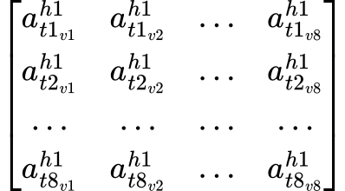
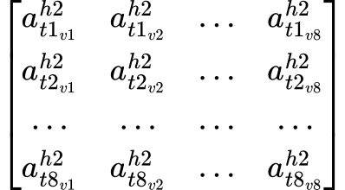
Multi-head
8X8
8X8

Slide 24
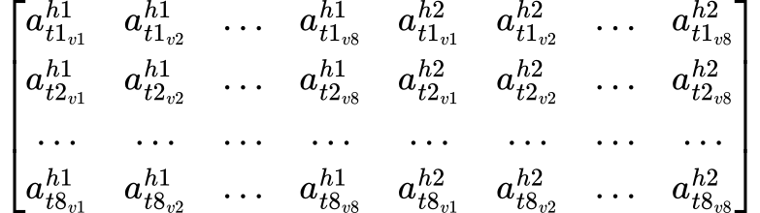
Multi-head
8X16

Slide 25
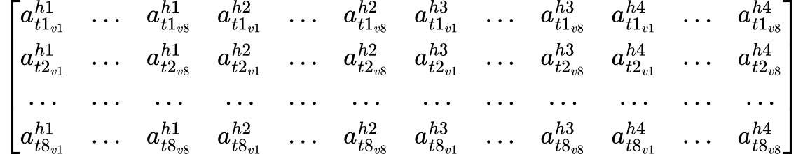
Multi-head
8X32
HEAD 1
HEAD 2
HEAD 3
HEAD 4

Slide 26
Multi-head
Still remember the shape of the original input?

Slide 27
A visual of what we have learned so far
HEAD
-inf mask
Head size= 8
q
…
·
Softmax
to each row
w
·
v
k^{T}
…
8X32
…

Slide 28
Multi-head
8X32
HEAD 1
HEAD 2
HEAD 3
HEAD 4

Slide 29
Feedforward
…
8X32
… …
… …

Slide 30
Attention block
HEAD 1
a^{h1}
a^{h2}
HEAD 2
a
Feedforward
x
HEAD 3
a^{h3}
HEAD 4
a^{h4}

Slide 31
N attention blocks
Block 1
Block 2
……
x
a^{b1}
a^{b2}
a^{b96}

Slide 32
Any questions?

Slide 33
Positional encoding
Motivation
The order of the words in a sequence matters.

Slide 34
Positional encoding
Even though she did not win the award, she was satisfied.
Even though she did win the award, she was not satisfied.

Slide 35
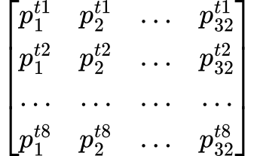
Positional encoding
+

Slide 36
Positional encoding
+

Slide 37
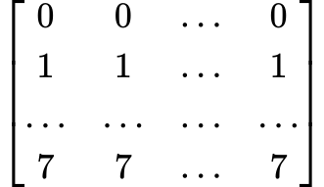
Positional encoding
+

Slide 38
Positional encoding
+

Slide 39
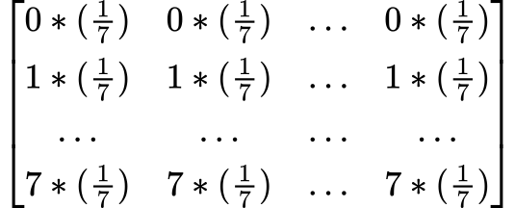
Positional encoding
+

Slide 40



Positional encoding
i=0
i=1
……
i=32
pos=0
d=32

Slide 41
Positional encoding
Even though she did not win the award, she was satisfied.
Even though she did win the award, she was not satisfied.

Slide 42
Any questions?

Slide 43
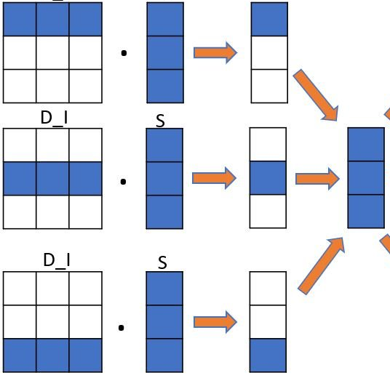
Parallel computation

Slide 44
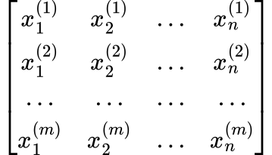
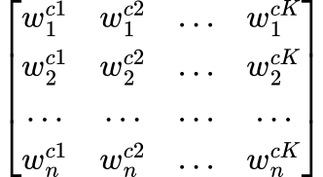

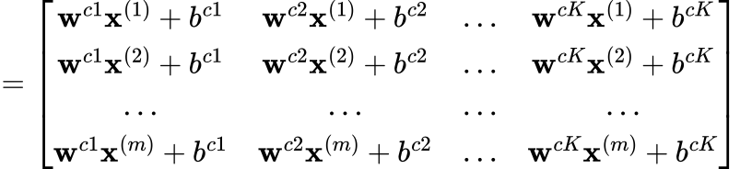
Calculate all observations at one time:
Matrix multiplication
w^{c1}
w^{c2}
w^{cK}
x⁽¹⁾
x⁽²⁾
x^{(m)}

Slide 45
Calculate all observations at one time:
Matrix multiplication
w^{c1}
w^{c2}
w^{cK}
x⁽¹⁾
x⁽²⁾
x^{(m)}

Slide 46
Calculate all observations at one time:
Matrix multiplication
w^{c1}
w^{c2}
w^{cK}
x⁽¹⁾
x⁽²⁾
x^{(m)}

Slide 47
Calculate all observations at one time:
Matrix multiplication
w^{c1}
w^{c2}
w^{cK}
x⁽¹⁾
x⁽²⁾
x^{(m)}

Slide 48
Calculate all observations at one time:
Matrix multiplication
w^{c1}
w^{c2}
w^{cK}
x⁽¹⁾
x⁽²⁾
x^{(m)}

Slide 49
Calculate all observations at one time:
Matrix multiplication
w^{c1}
w^{c2}
w^{cK}
x⁽¹⁾
x⁽²⁾
x^{(m)}

Slide 50
References
Jurafsky, Daniel, and James H. Martin. (2023). Speech and language processing: An introduction to natural language processing, computational linguistics, and speech recognition.
Karpathy, Andrej. (2023), GitHub repository, https://github.com/karpathy/nanoGPT
Karpathy Andrej. (2023). Let's build GPT: from scratch, in code, spelled out. [Andrej Karpathy]. YouTube. Retrieved September 5, 2023 from https://www.youtube.com/watch?v=kCc8FmEb1nY
Vaswani, Ashish et al. (2017). Attention is all you need. In Advances in Neural Information Processing Systems. 5998–6008.

